Slide 1
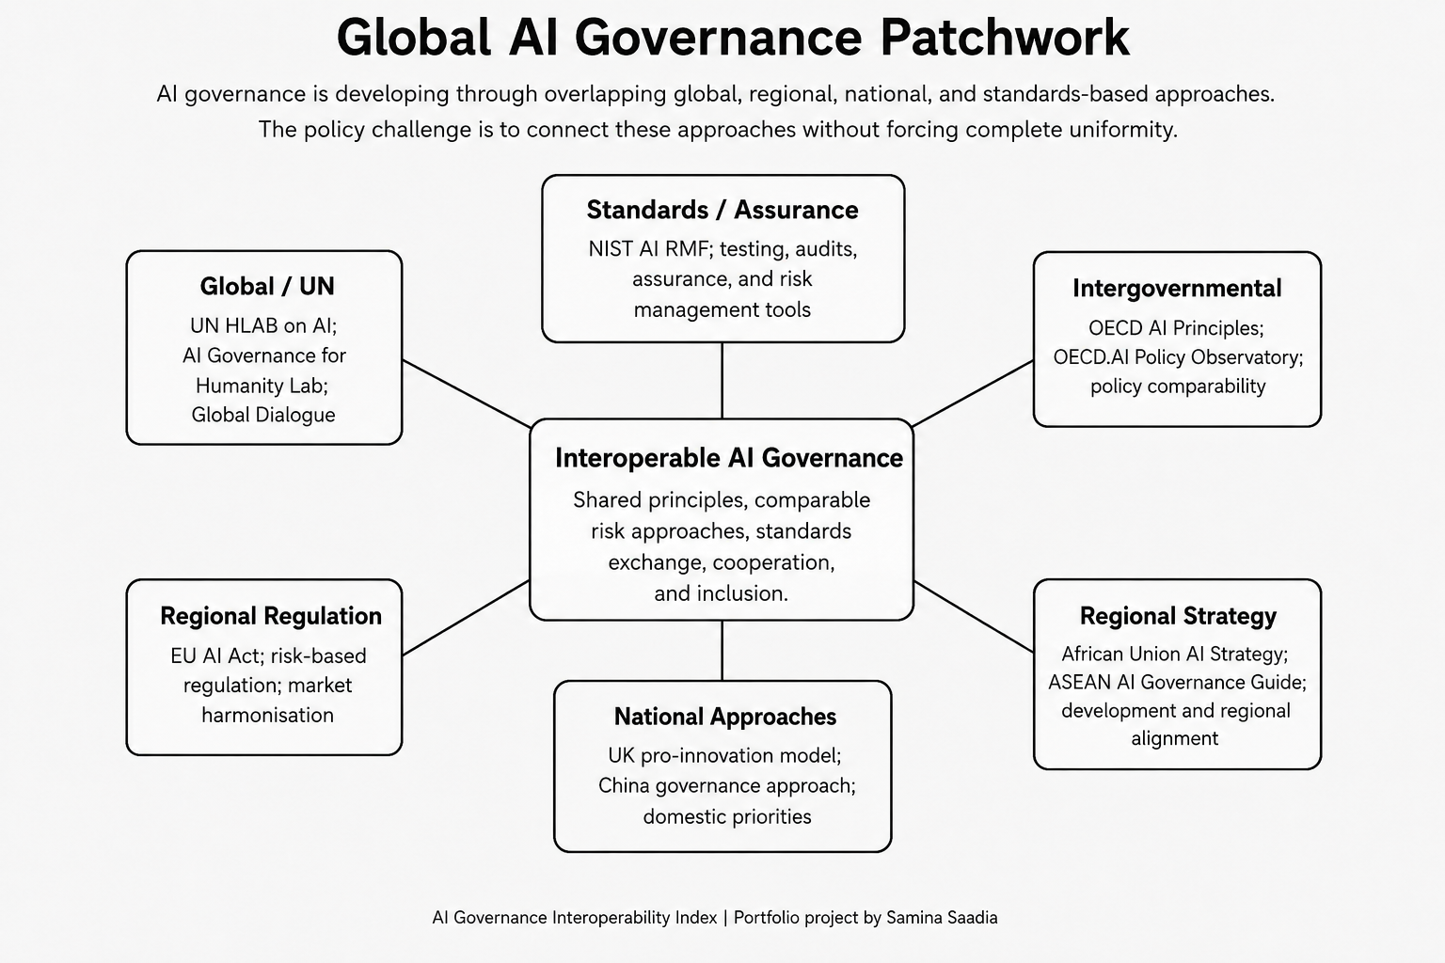
AI Governance
Interoperability Index
Mapping fragmentation and pathways for inclusive global AI governance
Policy synthesis portfolio deck
Samina Saadia
AI governance | Digital cooperation | Policy synthesis | Visual communication
Prepared as a compact, evidence-based portfolio product for international digital governance roles.
AI Governance Interoperability Index | Samina Saadia
01

Slide 2
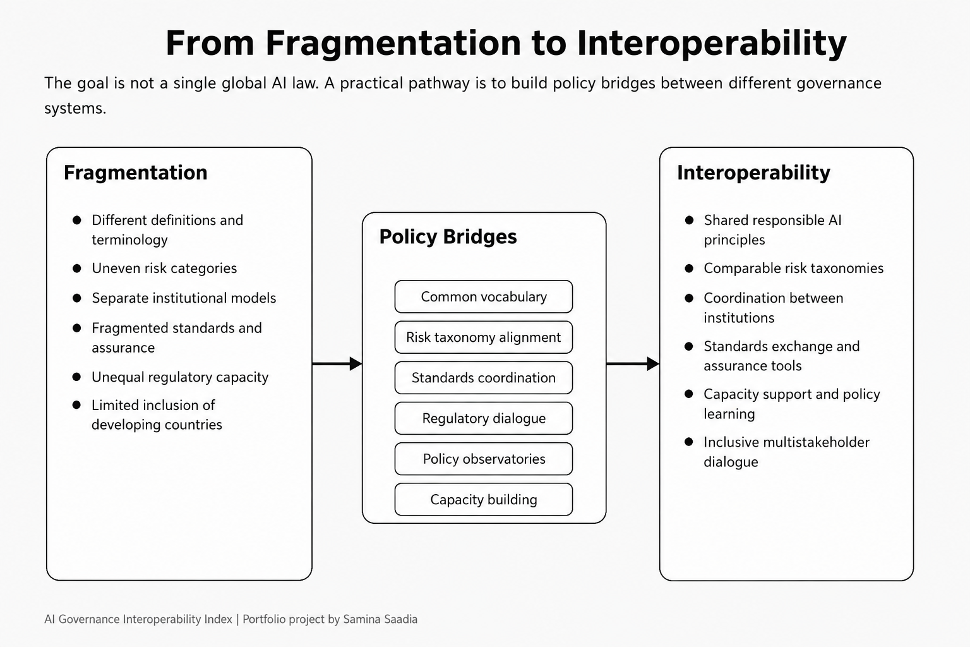
Why AI governance interoperability matters
AI systems and AI risks move across borders faster than policy systems can align.
The policy challenge is not to force one global model, but to help different governance systems communicate, compare, cooperate, and learn.
Different laws, principles, standards, and institutional models are emerging at the same time.
Fragmentation can make cooperation, accountability, and implementation harder.
Interoperability creates practical bridges: shared vocabulary, risk taxonomies, standards exchange, policy dialogue, and capacity support.
AI Governance Interoperability Index | Samina Saadia
02

Slide 3
Study design and analytical approach
A compact comparative mapping of selected global, regional, and national AI governance frameworks.
Selected frameworks
Six scoring dimensions
UN High-level Advisory Body on AI
UN AI Governance for Humanity Lab
OECD AI Principles and OECD.AI Observatory
EU AI Act, AU Strategy, ASEAN Guide
UK approach, US NIST AI RMF, China approach
Shared principles alignment
Risk classification clarity
Institutional coordination
Standards and assurance linkages
International cooperation
Inclusion and capacity building
Scoring method
Each dimension is scored from 1 to 5. The total score is calculated out of 30 and converted into an interoperability readiness percentage. Scores are interpretive and evidence-based, not official rankings.
AI Governance Interoperability Index | Samina Saadia
03

Slide 5
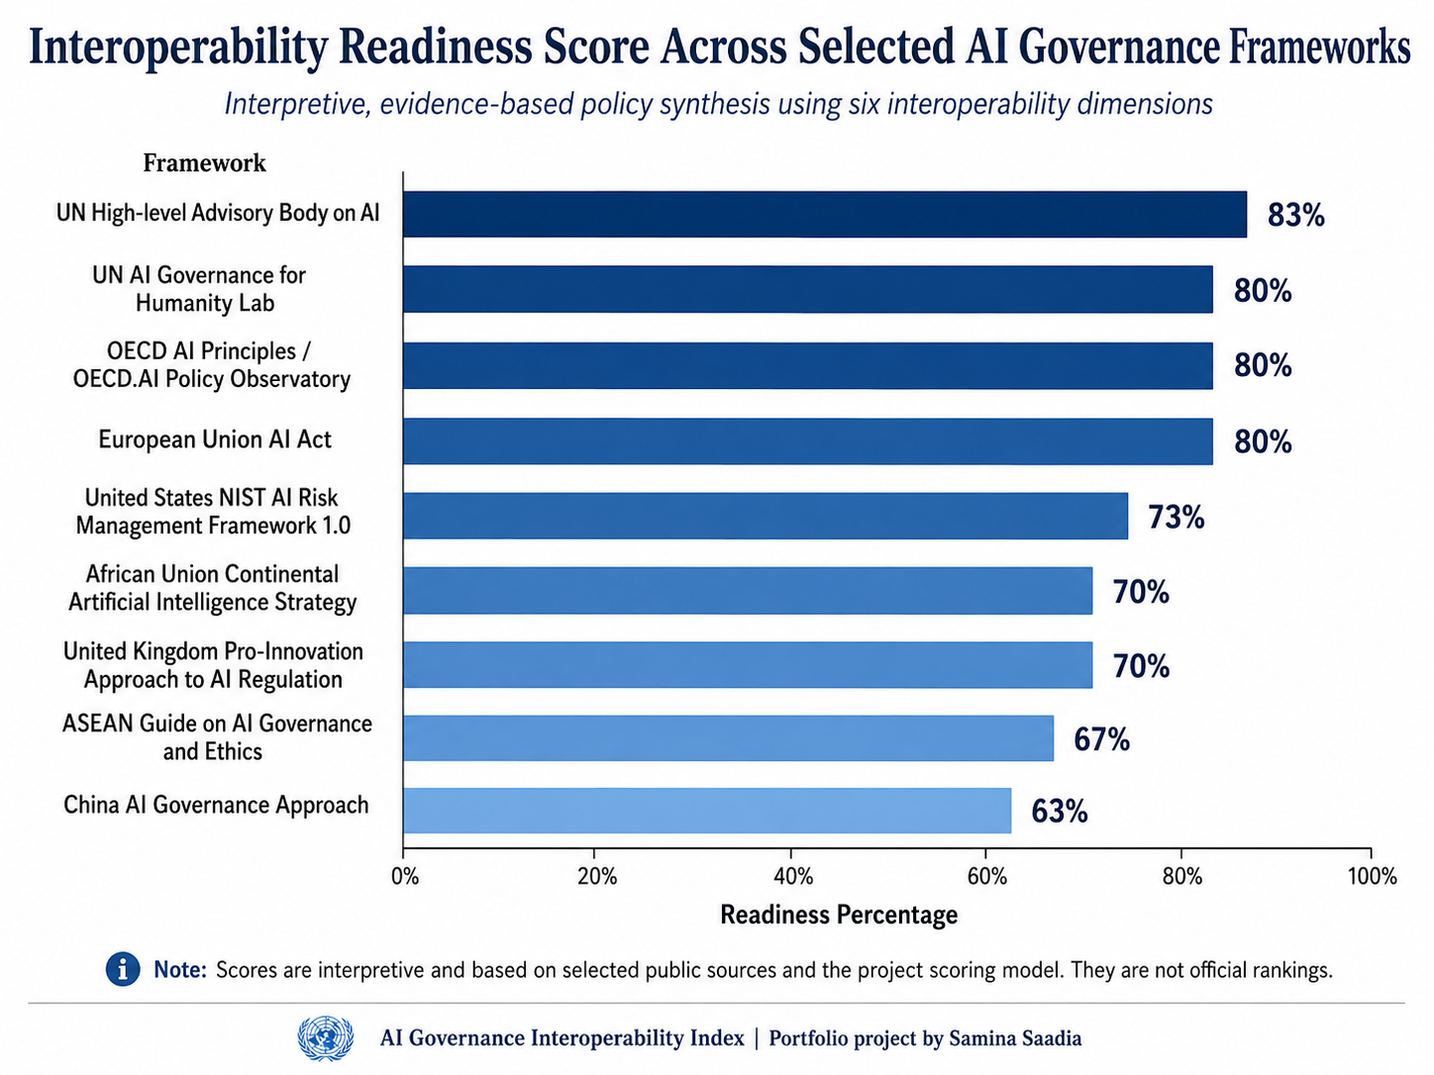

Slide 6
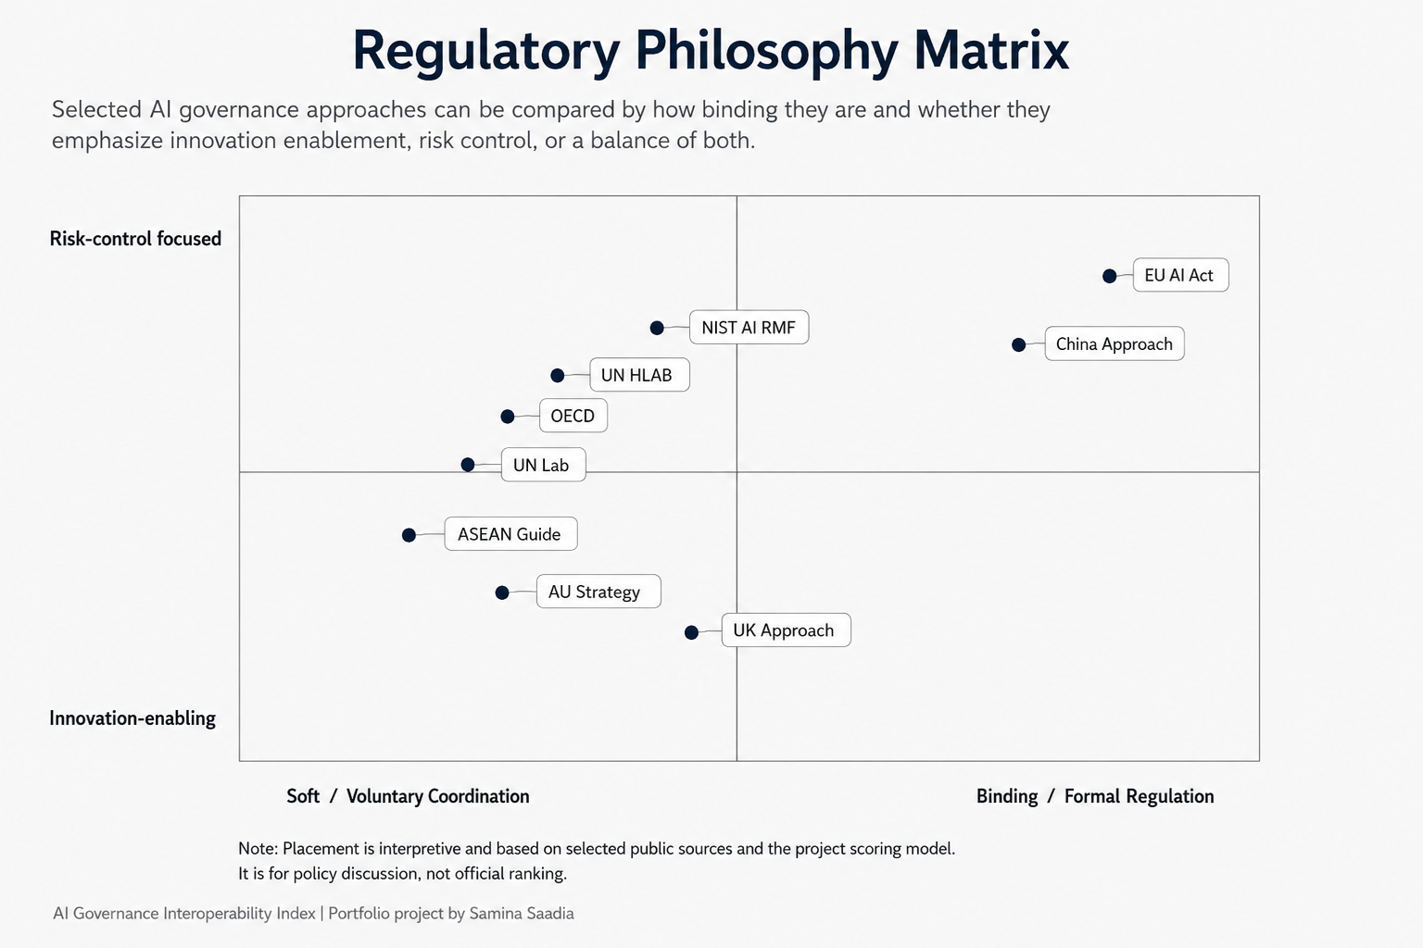

Slide 8
What this portfolio project demonstrates
A concise proof of capability for AI governance synthesis and visual policy communication.
Core outputs
Capabilities evidenced
Comparative mapping table and scoring workbook
Policy brief with clear narrative and evidence notes
Visual artefacts for white-paper style communication
Presentation-ready synthesis deck
Neutral synthesis of complex governance inputs
Comparative policy analysis across countries and regions
Translation of abstract governance concepts into clear visuals
Structured, iterative documentation for international audiences
Closing message
AI governance interoperability is less about uniformity and more about connection: shared principles, comparable risk approaches, standards exchange, cooperation, and inclusion.
AI Governance Interoperability Index | Samina Saadia
08

